Slide 1
The True Story of Smokey Bear A true story that happened in Lincoln National Forest in Mexico

Slide 2
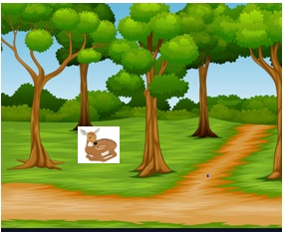
It was hot day. A deer was resting in the shade of pines.

Slide 3
A little brown- coloured bear cub had left his mother while she was dozing.

Slide 4
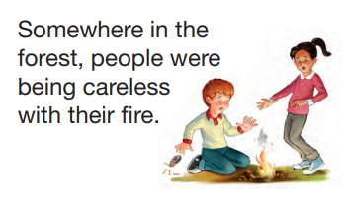
A little bear cub like to play in the green meadow

Slide 5
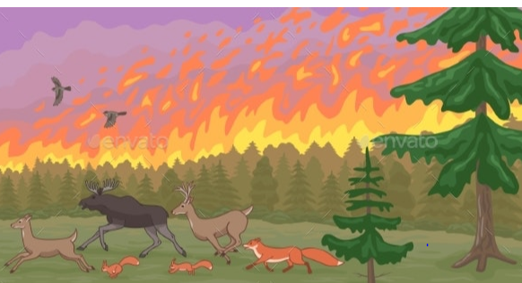
Birds and animals panicked as flames roared along ! In the heat and smoke, some were wounded.

Slide 6
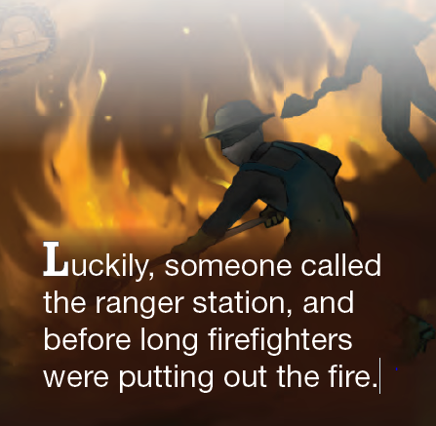

Slide 7
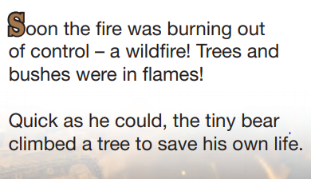
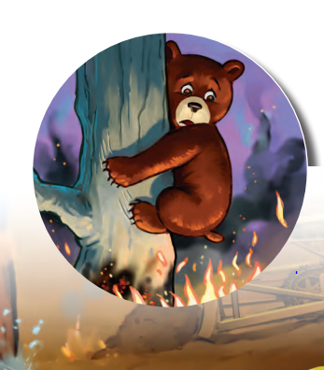
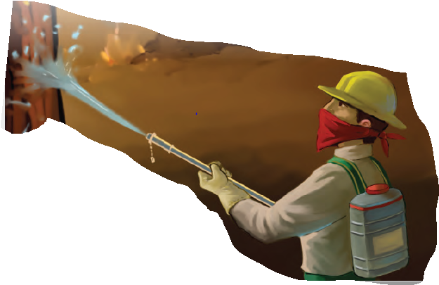
It took five days to bring the fire under control. Over 17,000 acres of timbers were burnt, countless animals killed, grass scorched, and the land became barren.

Slide 8
A fire fighter rescued the cub who was injured and very scared.
The little bear cub looked around- the beautiful forest had gone; trees were all burnt down and disfigured; the rivers and streams were filled with dirt and wood ashes.

Slide 9
The little bear cub saw some of his friends lying on the ground, not moving at all.
They were all burnt alive.
Then his mother came to his mind.
Tears rolled down on the little bear cub’s cheeks.
Now, he had to live in a strange land, all his friends had died, and he wouldn’t have anyone to call ‘mummy’ anymore!

Slide 10
They came out of the burnt- out forest, Veterinarians treated his wounds and burns carefully.

Slide 11
Days passed, he became better and better; his wounds got healed and his burnt –out hair started growing back , he was finally able to walk again.
Fireman named the little cub ‘Smokey’.
Children, young and old would come to see him every day and play with him.

Slide 12
His home was destroyed, so from New Mexico, Smokey Bear was flown to Washington DC.
A huge crowd of people came to greet and welcome him.
Forest rangers put their hat on him and took his photo.
Newspapers and TV ran his story.
He became a star on radio and TV programmes .
Smokey Bear grew up and promised that he could teach people how to prevent wildfires.

Slide 13
Smokey Bear wants you to know the five rules of fire prevention.
Rule 1:Only you can prevent wild fires.
Rule 2: Always be careful with fire.
Rule 3: Never play with matches or lighters.
Rule 4: Always watch your campfire.
Rule 5: Make sure your campfire is completely out before leaving it.
SMOKEY BEAR NEEDS YOU TO FOLLOW THESE RULES TO HELP TO PREVENT WILD FIRES.

